Slide 1

Delivering Social Value

Slide 2

Overview
The importance of Social Value is increasing within public sector procurement and suppliers are increasingly being asked to demonstrate their contribution!
This workshop will help you:
Understand Social Value in a procurement context
Introduce you to a free Social Value Action Planning Tool
Provide you with guidance on how to communicate your Social Value contribution to potential and existing customers

Slide 3
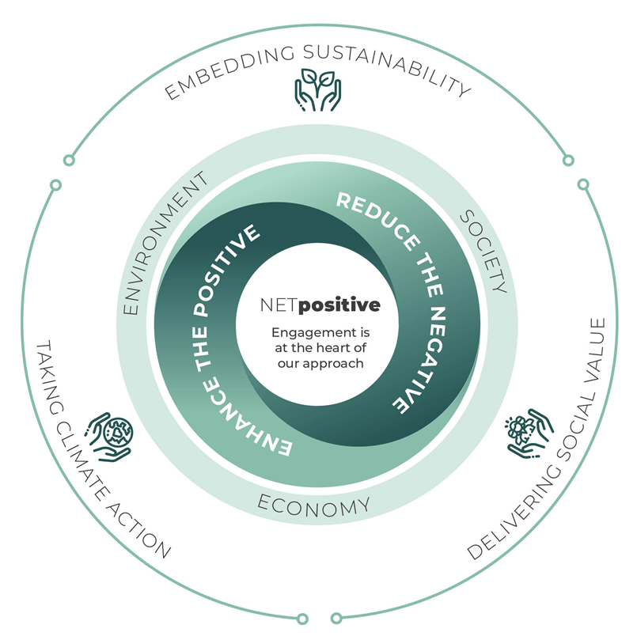
Notes:
About NETpositive Futures and our approach to sustainability / social value.

Slide 4
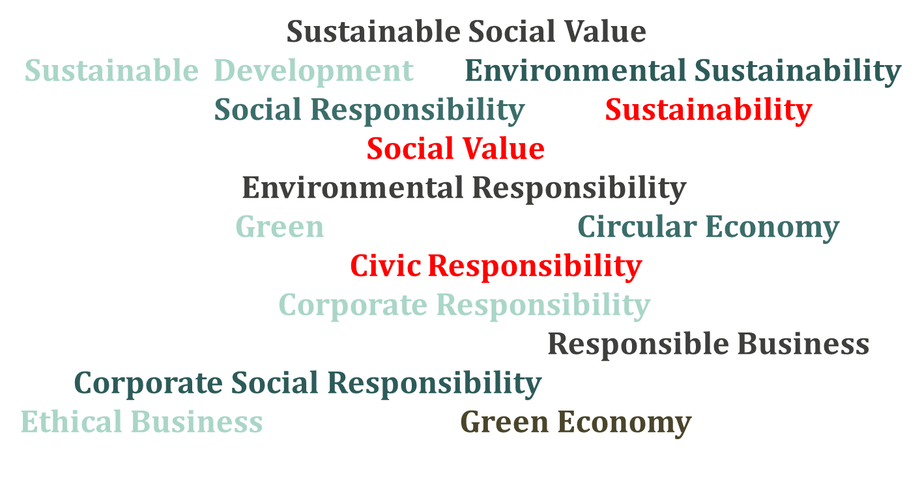
Notes:
A range of terms are used to describe sustainability / social value.

Slide 5
The modern day concept of sustainability was built on the work of Gro Harlem Bruntland
In 1987, the World Commission on Environment and Development (WCED), published a report entitled, ‘Our common future’. The document came to be known as the ‘Brundtland Report’ after the Commission's chairwoman, Gro Harlem Brundtland. It developed guiding principles for sustainable development as it is generally understood today.
Notes:
The Brundtland Report stated that critical global environmental problems were primarily the result of the enormous poverty of the South and the non-sustainable patterns of consumption and production in the North. It called for a strategy that united development and the environment – described by the now-common term ‘sustainable development’
Sustainable development is defined as follows:
Sustainable development is development that meets the needs of the present without compromising the ability of future generations to meet their own needs’

Slide 6

Notes:
SDGs as the global sustainability strategy.

Slide 7
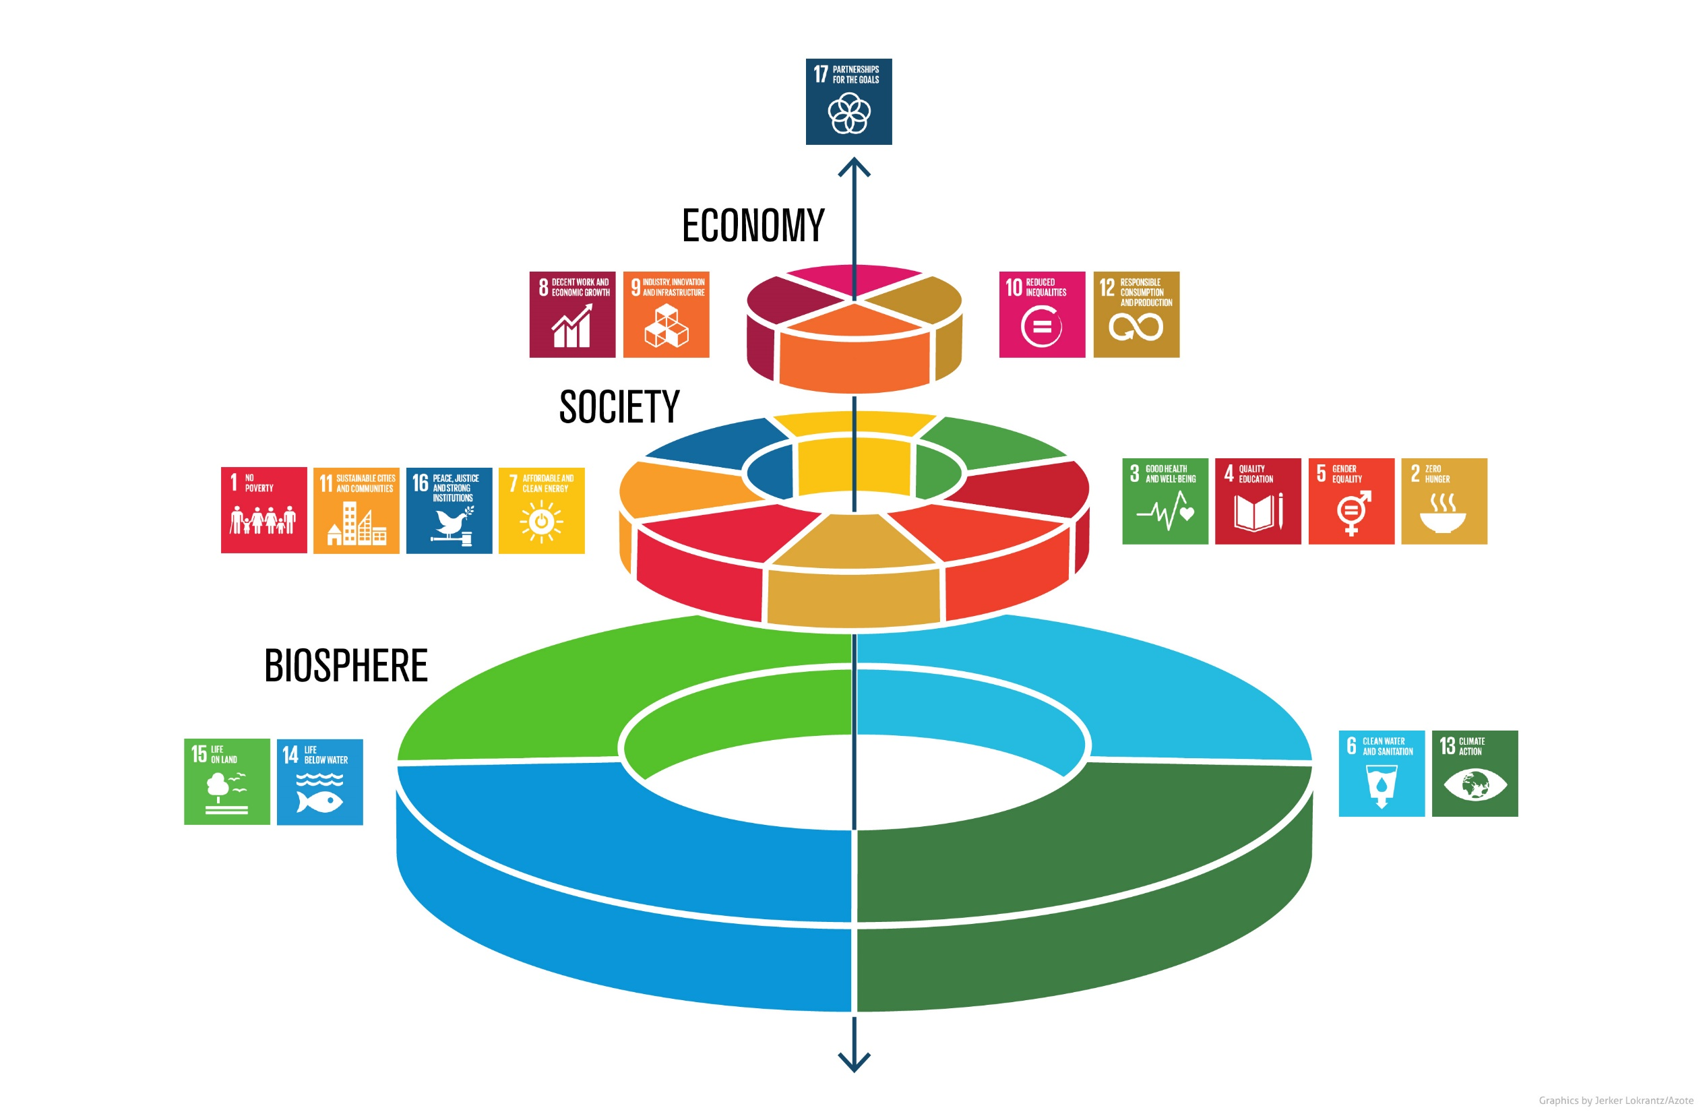

Slide 8
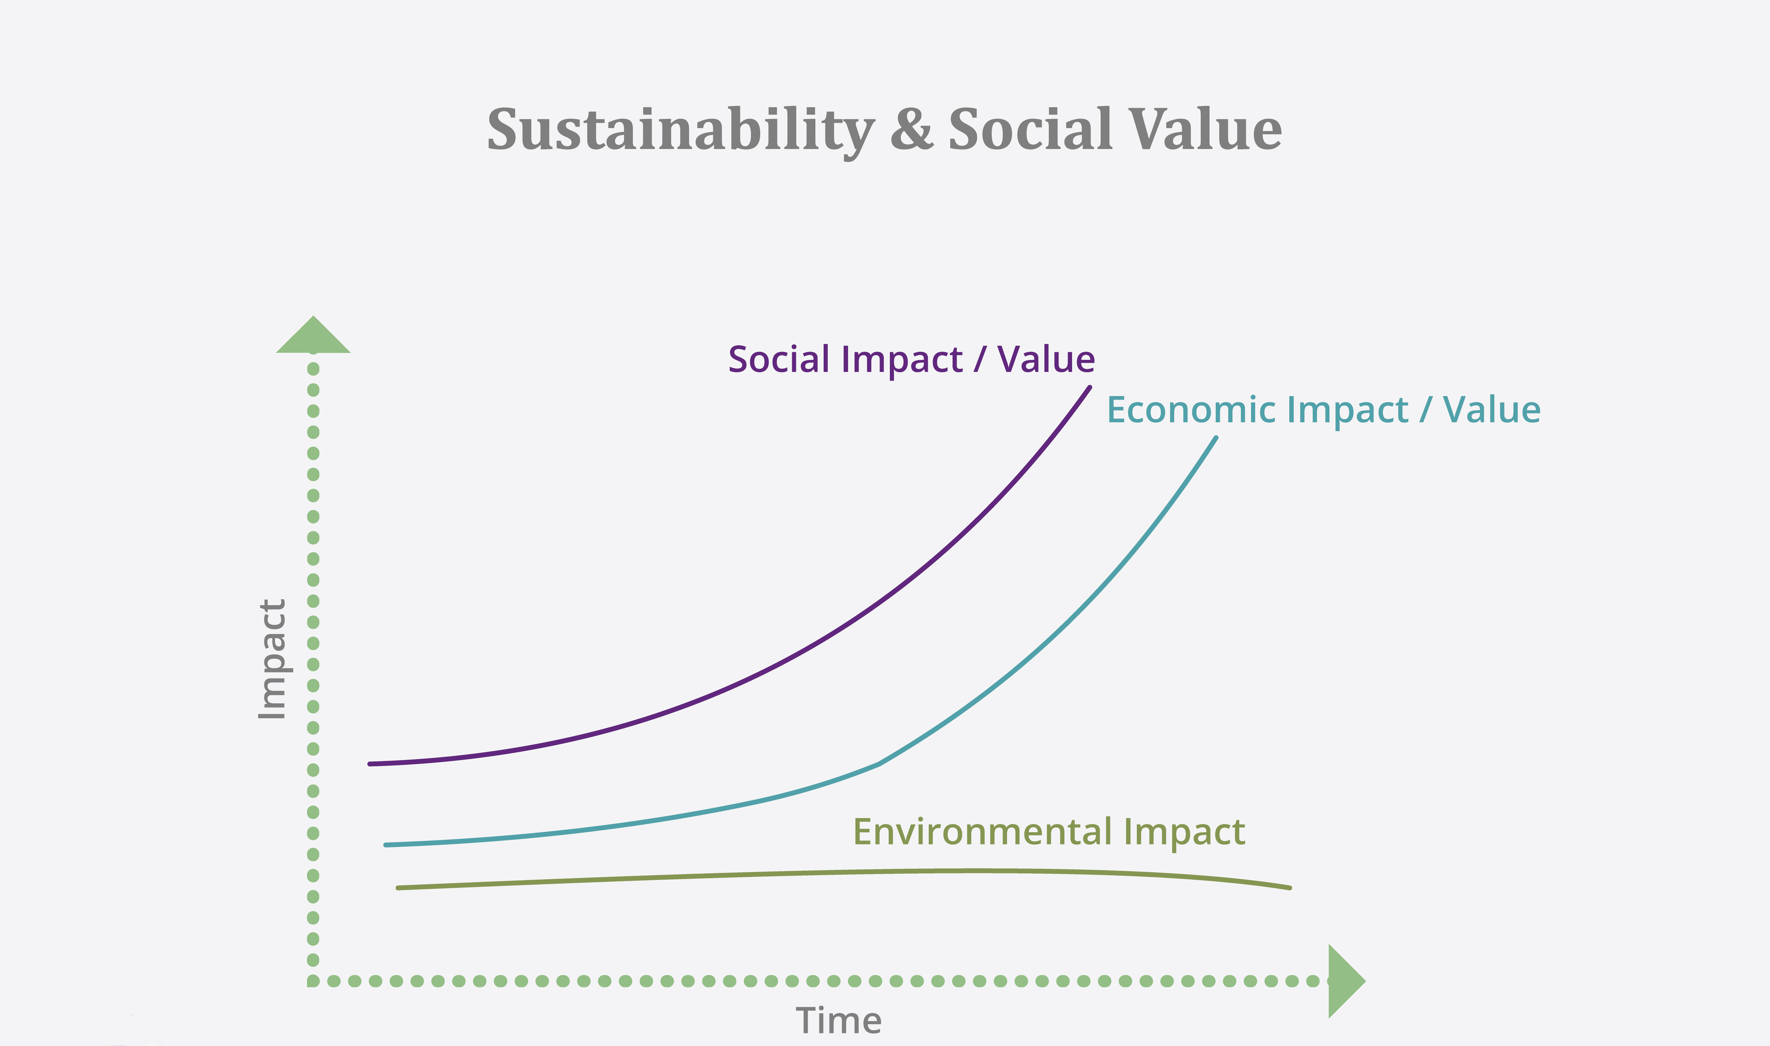
Notes:
Different teams and organisations can have different impacts and add value in different areas – it depends what your core business is.

Slide 9
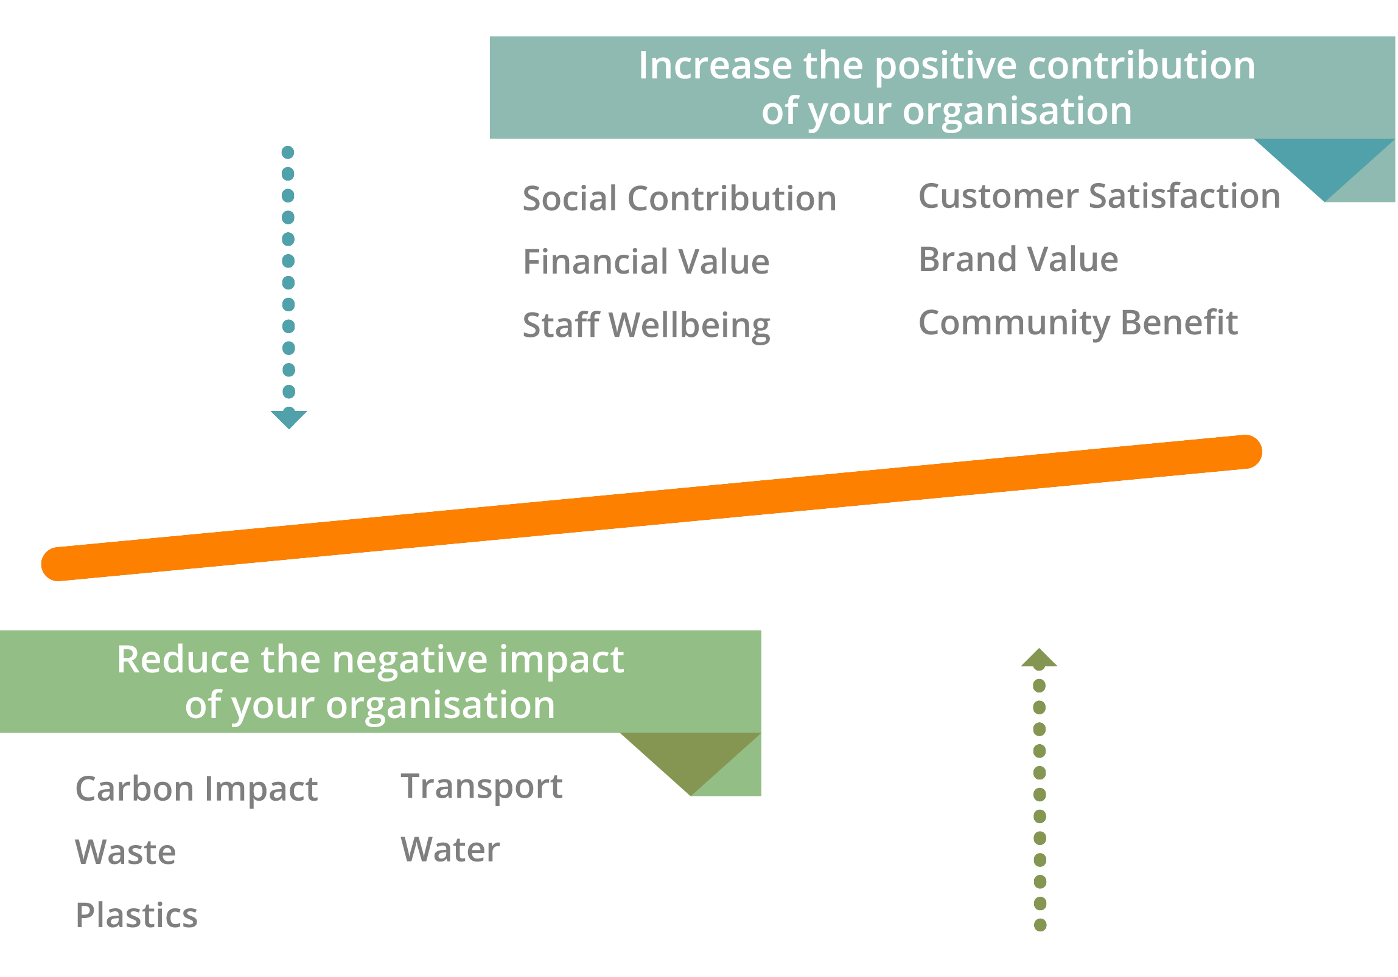
What is NETpositive Sustainability?
Notes:
Before we finalise our definition of sustainability there is one other concept which is critical to the current thinking. The essence is this: (once again this is a generalisation which is generally true)
The early activities around sustainability were focussed on reduction of negatives, do less, waste less travel less, you do bad things and need to change. It is true that we all have a host of negative impacts at an individual and collective level – which we do need to reduce. But this led to negative messaging and a lack of engagement in some areas
However, the concept of NETpositive sustainability emphasises a greater focus on the good we can do how do we maximse our social and economic contribution, how do we take what our contribution is through our work and department and build opportunities to increase value in all dimensions. Environmentally, socially and economically.

Slide 10

Social Value
Social
Economic
Environment
Social Responsibility
Social
Economic
Environment
Corporate Social Responsibility
Social
Economic
Environment
Environmental Sustainability
Environment
Social
Economic
Sustainability
Environment
Social
Economic
Notes:
At the heart of all of these responses are a consideration of the environmental, social and economic considerations. However the different language sets emphasise different priorities within the response. The most obvious ones are at the extremes, where an organisational commitment to Environmental Sustainability – tends to ignore the social and economic. And Social Value (whilst the government definition focusses on environmental, social and economic) the response of those making a social value commitment tend to primarily focus on the social and economic.
Whilst this is a slight generalisation it is generally true and can be tested quite simply be asking a colleague to either describe social value or environmental sustainability, and listen to their response. The language leads us in that direction.
This not a helpful state of affairs. Therefore we are going to provide you with a definition of sustainability which is both congruent and engaging.

Slide 11
Have we developed a clear and shared understanding?
  Environmental, social and economic elements
  Reducing negative impacts
  Enhancing positive contribution
  Taking a long term perspective
All of this relates to your core business practice.
Social Value = Sustainability
Notes:
Has the team got that clarity about what sustainability is? That means they can start to think about what it means in the context of BLC.

Slide 12
Let’s put the theory into action!
How do we know if a business understands sustainability or social value?
Where would the focus be?
A Bank
A University
Print management company
Clothing Manufacturer

Slide 13
What does the supplier tool do?
Support Suppliers
Provides all suppliers with a free Social Value Action Plan
Supports Engagement
Supports suppliers on multiple issues current and emerging
Demonstrates Impact
Against BLC, Forces and PCC priorities
Guidance, support and help to understand and deliver social value
We discuss action plans as part of contract management
Use data from the plans inform category management
Modern Slavery Reporting
Carbon Reduction
Contribution to the SDGs
A plan they can use with all public sector clients
Notes:
High level

Slide 14
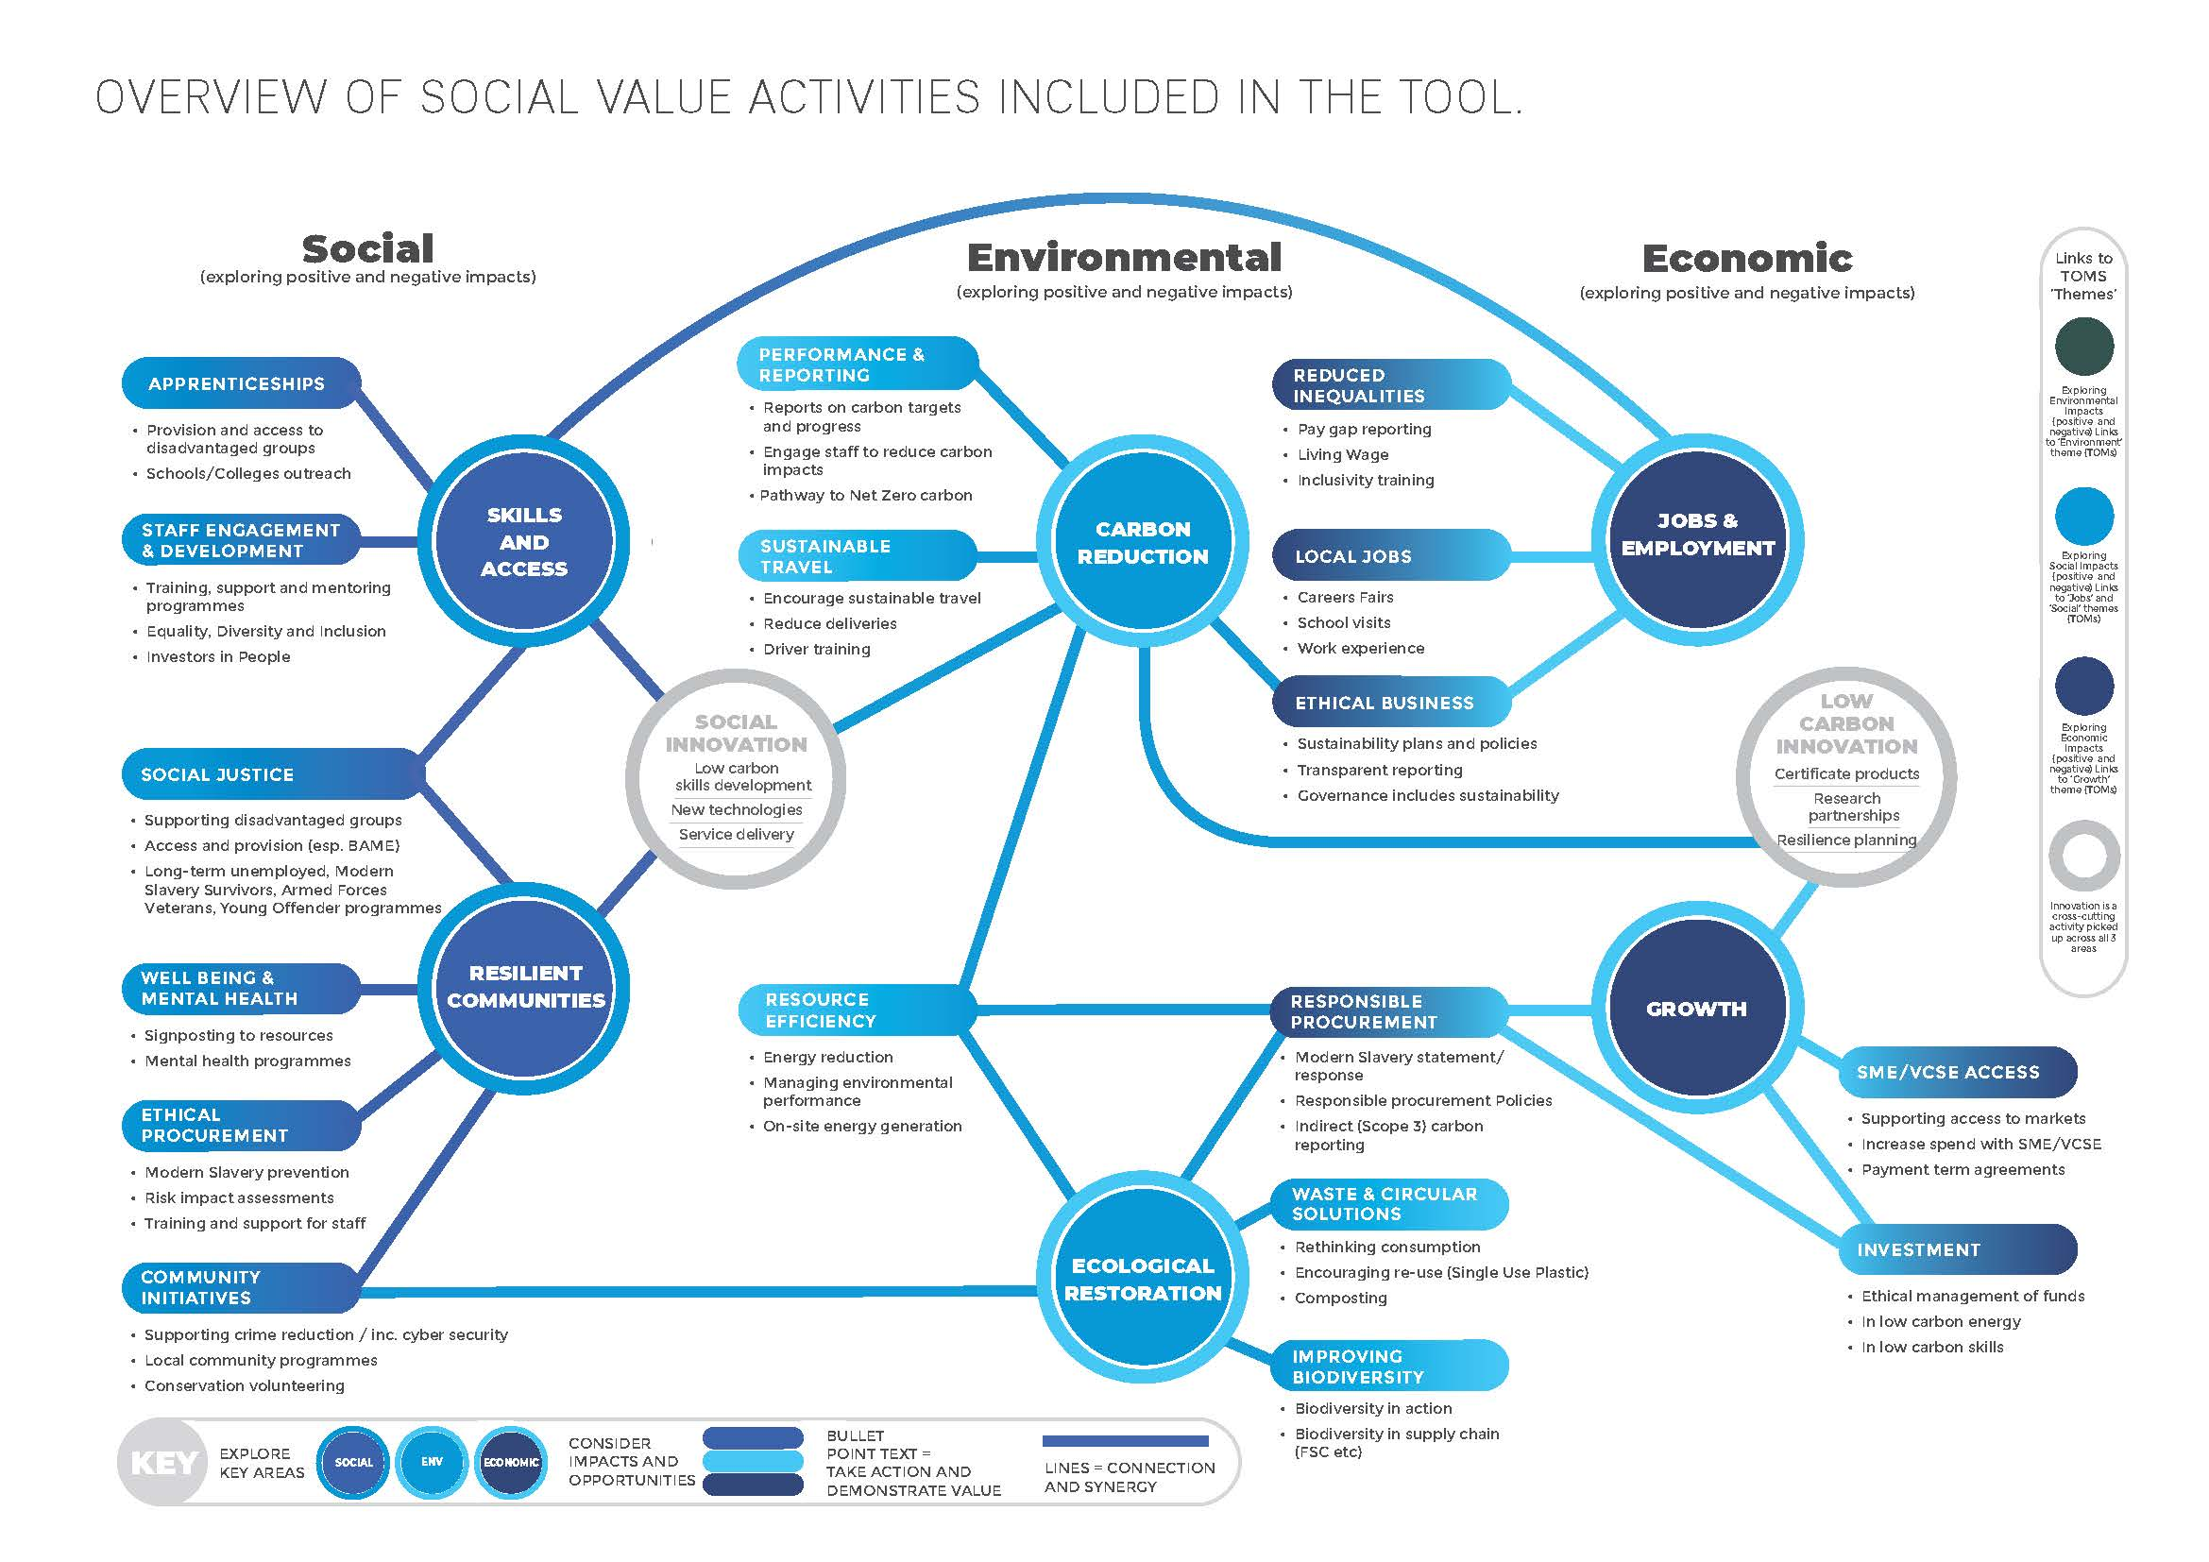
Notes:
Overview of the content

Slide 15
About the supplier
Size, location, type of business
Goods or services, who they supply
Select key business issues
Looking at the type of business what are the material issues associated with their business activity
Can add edit existing issues of add new issues if they are not already suggested
Select actions to address the issues
For every issue they choose the tool suggests actions they can take
For every action they commit to they can provide evidence and tell us how they are progressing (not started, in progress, completed)
If they want to supply you
The actions are based on the about the supplier section
Notes:
Overview of the functionality

Slide 16
Tool Demonstration

Slide 17
Communicating Sustainability

Slide 18


Slide 19
Why is it an opportunity?
  Engage customers
  Build your profile
  Promote the team
  Show all the value you bring
  Approach Social Value with clarity and energy

Slide 20
Building the narrative
A spoken or written account of connected events; a story

Slide 21
“Storytelling may seem like an old-fashioned tool, today — and it is. That’s exactly what makes it so powerful. Life happens in the narratives we tell one another. A story can go where quantitative analysis is denied admission: our hearts. Data can persuade people, but it doesn’t inspire them to act; to do that, you need to wrap your vision in a story that fires the imagination and stirs the soul”

Slide 22


Slide 23
Social Value Story
Understand the business priorities
Understanding of your context
Stakeholder analysis and engagement
Discussion of risks and opportunities
Clear set of priorities with targets
Governance, reporting and review
Review of related strategic documents
Review of key stakeholder strategic documents
Identification and meaningful engagement
Mature recognition of challenges and opportunities
Measureable and stretching
Regular and visible

Slide 24
Thoughts, questions and reflections

Slide 25
Thank you
Presenter/Contact Name
jimmy@netpositivefutures.co.uk

