Slide 1
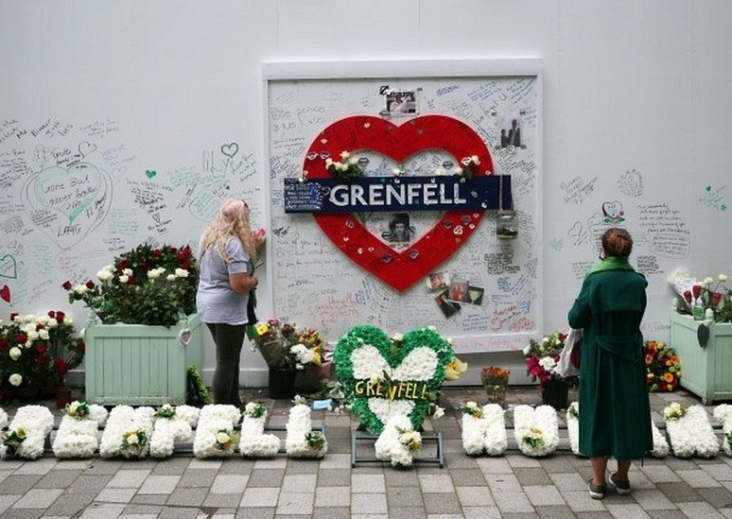
Wellbeing lessons learned from Grenfell Tower
A.langley@kent.ac.uk

Slide 2
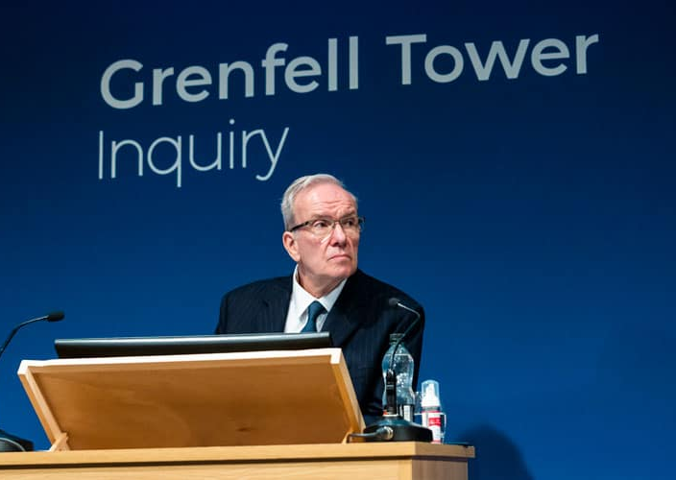
What you will not learn today
Still a live enquiry
Public inquiry still underway
Prosecution phase to follow

Slide 3
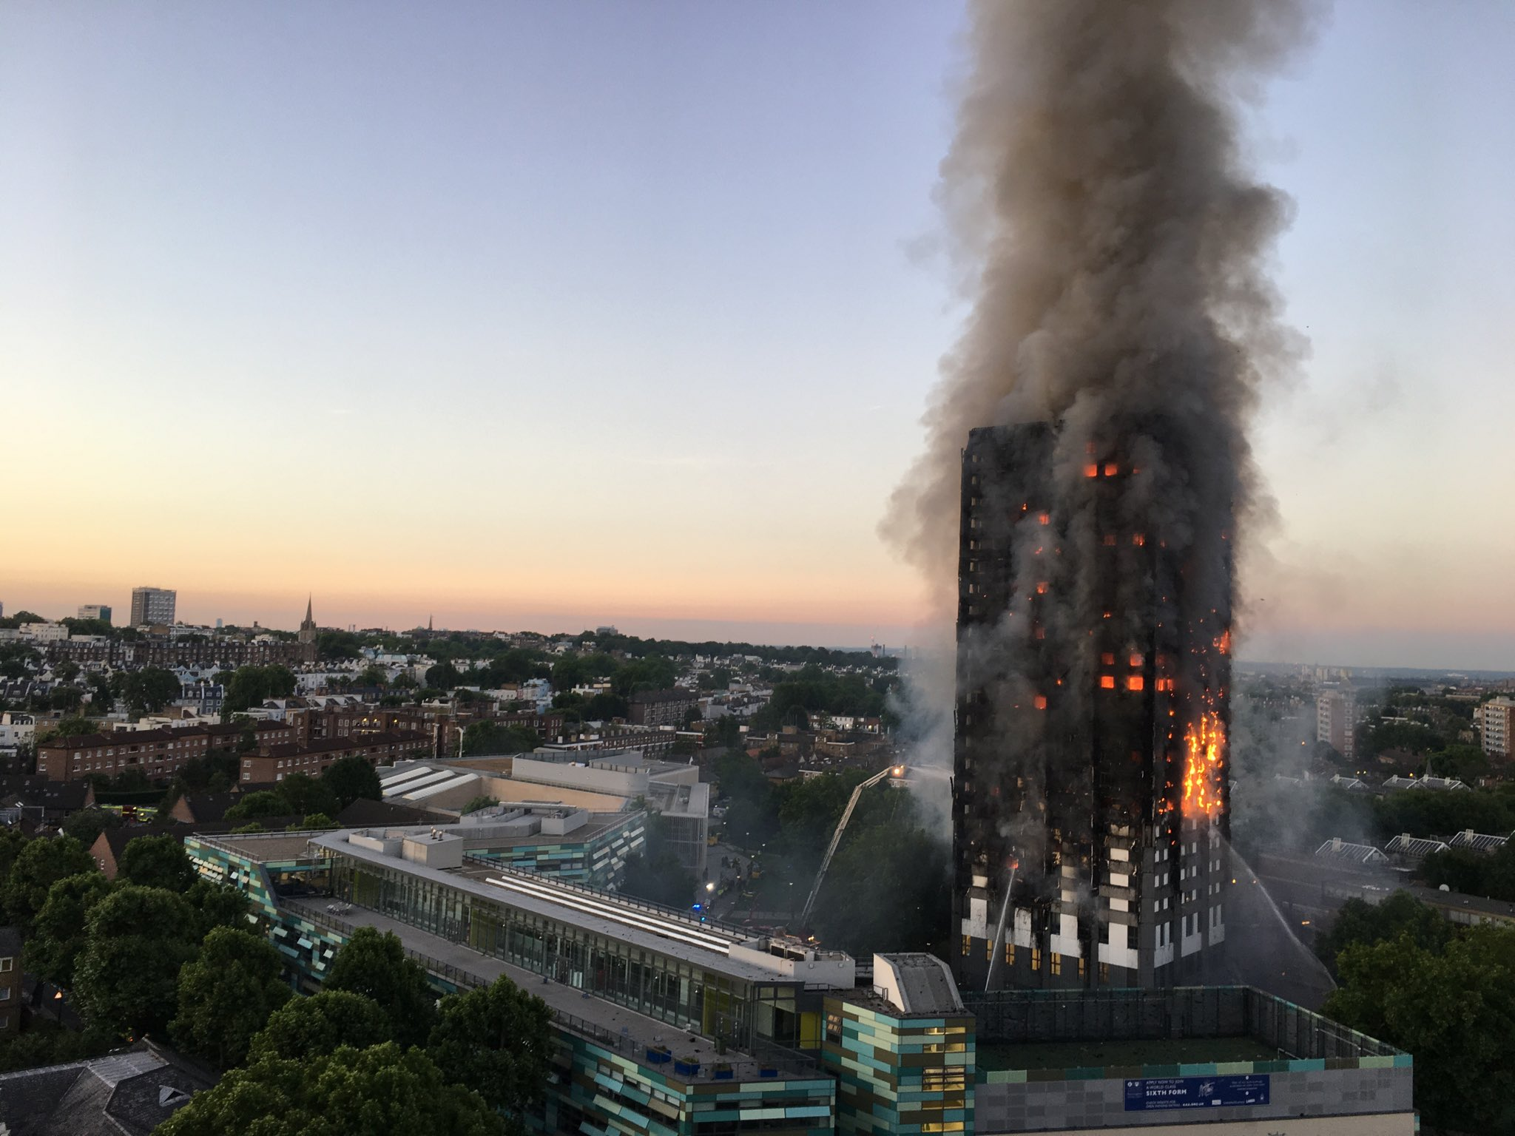
A reminder
15th June 2017.
Accepted to have caused 72 deaths.
The worst UK residential fire since the Second World War.
Burned for 60 hours.
250 fire fighters with 70 fire appliances
1400 people deployed as part of the Police response

Slide 4
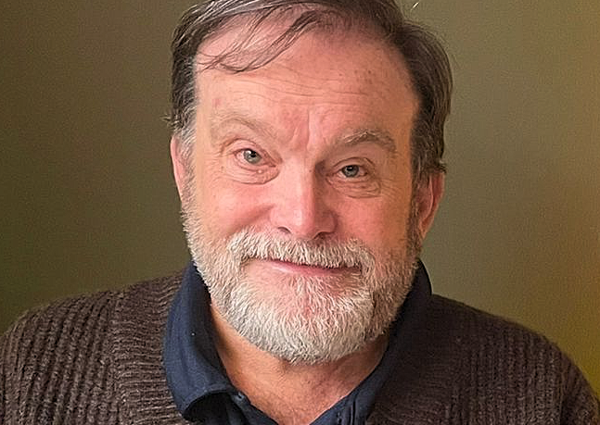
Why me
I was on duty
I answered the phone

Slide 5
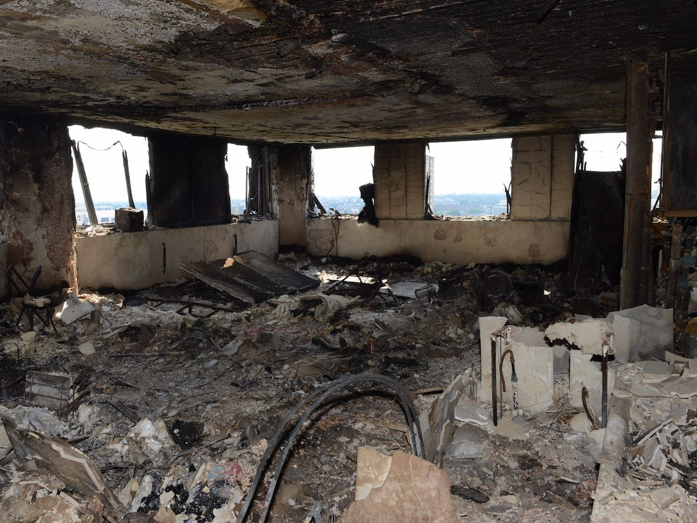
The scale of the problem
Very unstable structure.
Access problems.
Very hazardous conditions.
15.5 tonnes of debris per floor to sift.
Subletting.
Hidden communities.
Politicians and Royals!

Slide 6
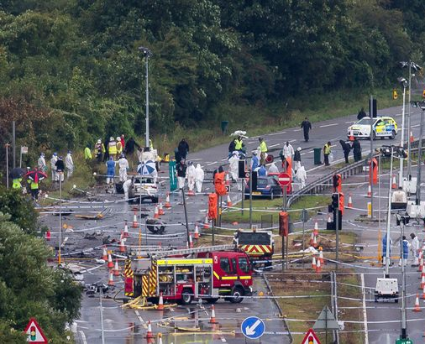
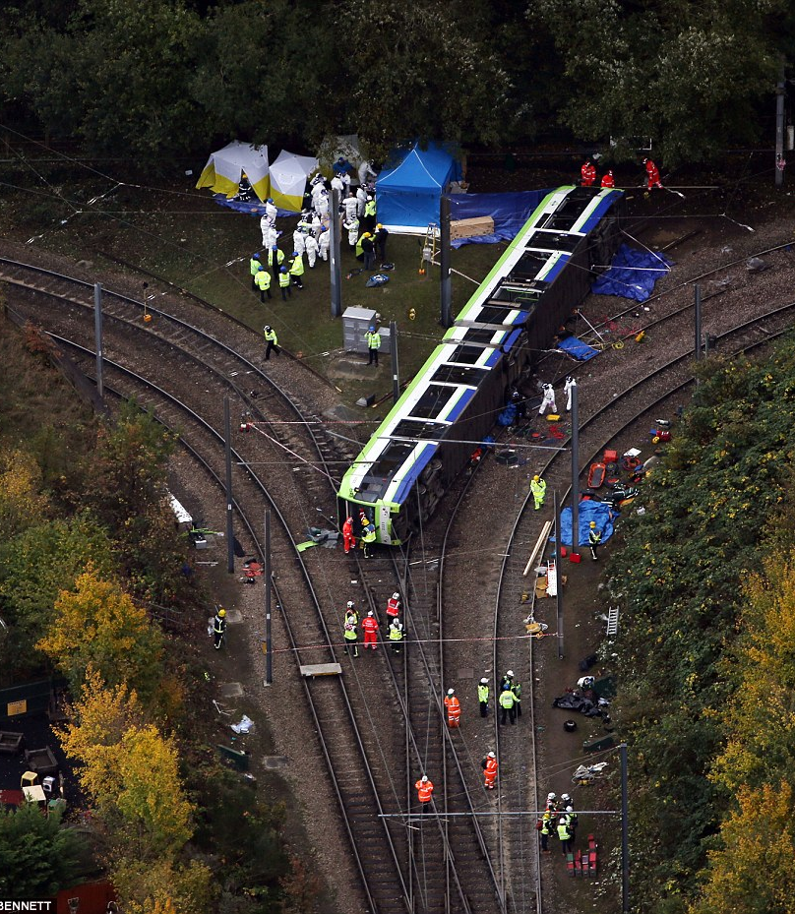
Identifying the problem
Police are good at dealing with disasters
Resources
People
Procedures
But for how long?

Slide 7
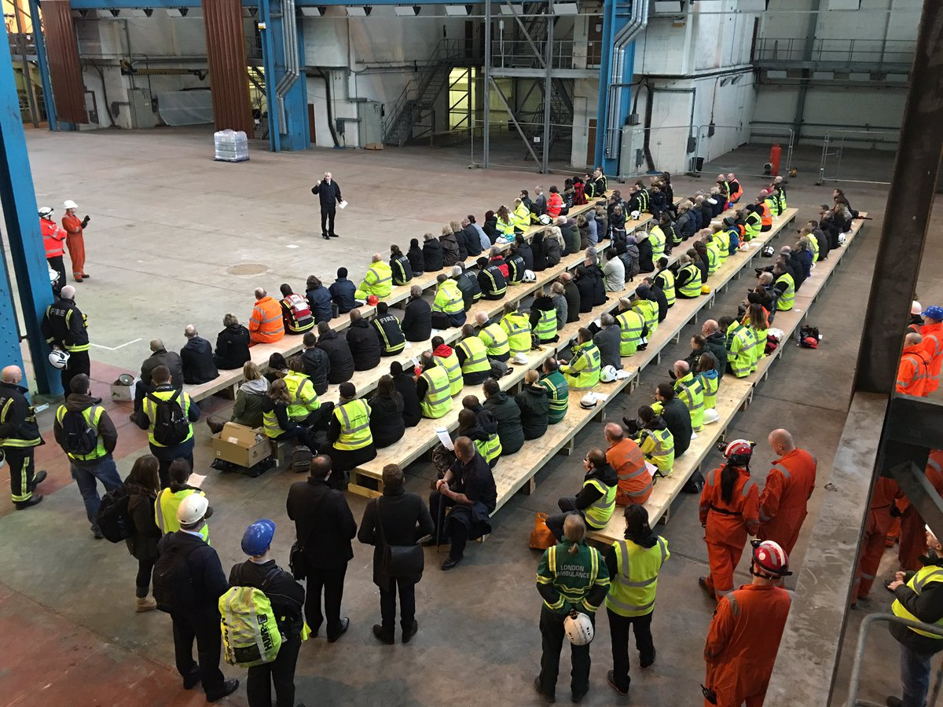
Solutions
Identify your “team”
Who are they?
Do you really know them?
It probably wont just be Police and Forensic staff

Slide 8
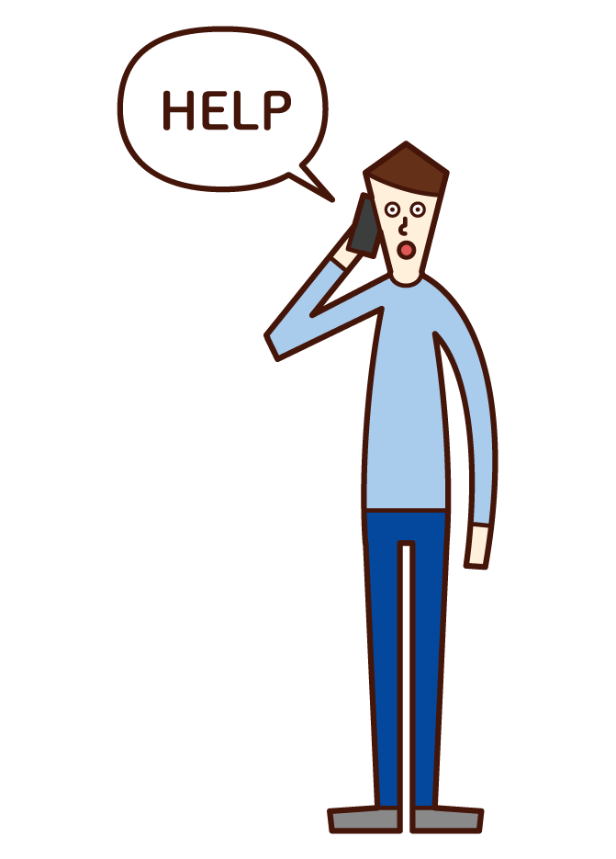
Solutions
Ask for help
You can’t do it all by yourself
Explain what you need and why
Be firm – they probably won’t fully understand what you are dealing with
Build a support team

Slide 9
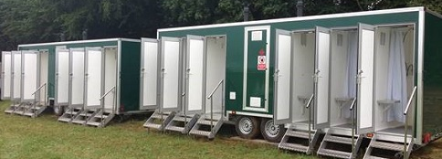
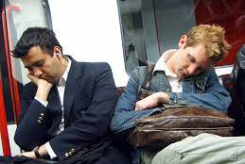
Solutions
Having Identified the problems
Are they solvable?
Will they be popular?

Slide 10
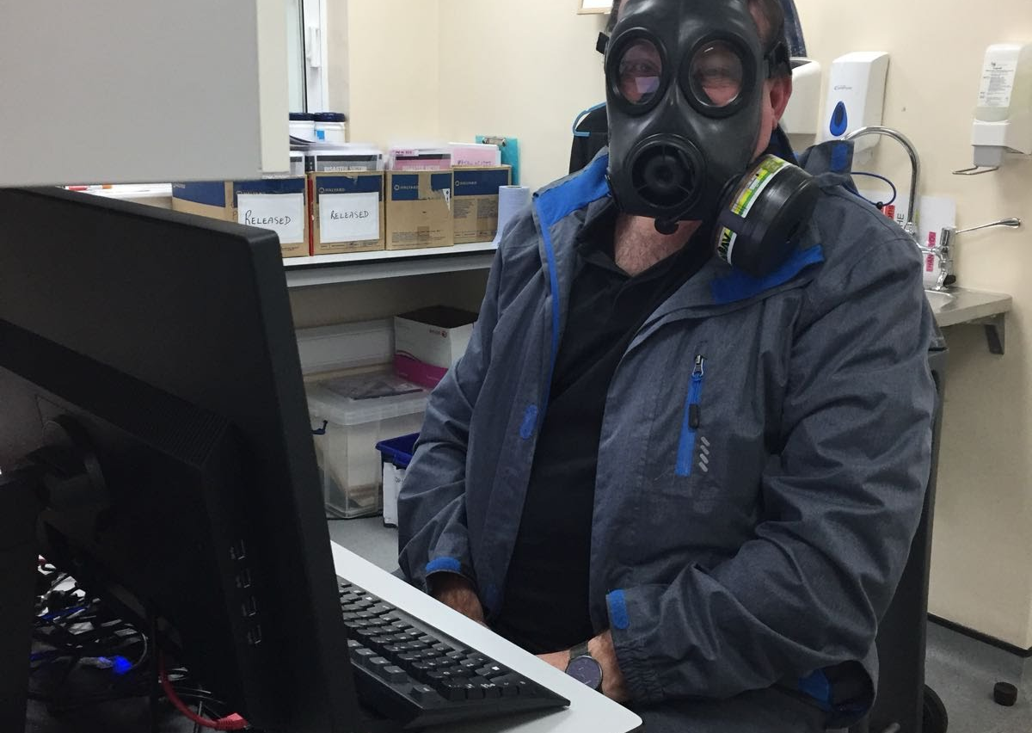
Solutions
Communicate – always
Respond to concerns
Be there, be available and be approachable

Slide 11
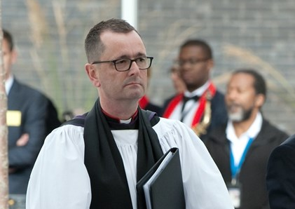
Solutions
Become a haven
Be bold – you might be surprised at the reaction!

Slide 12
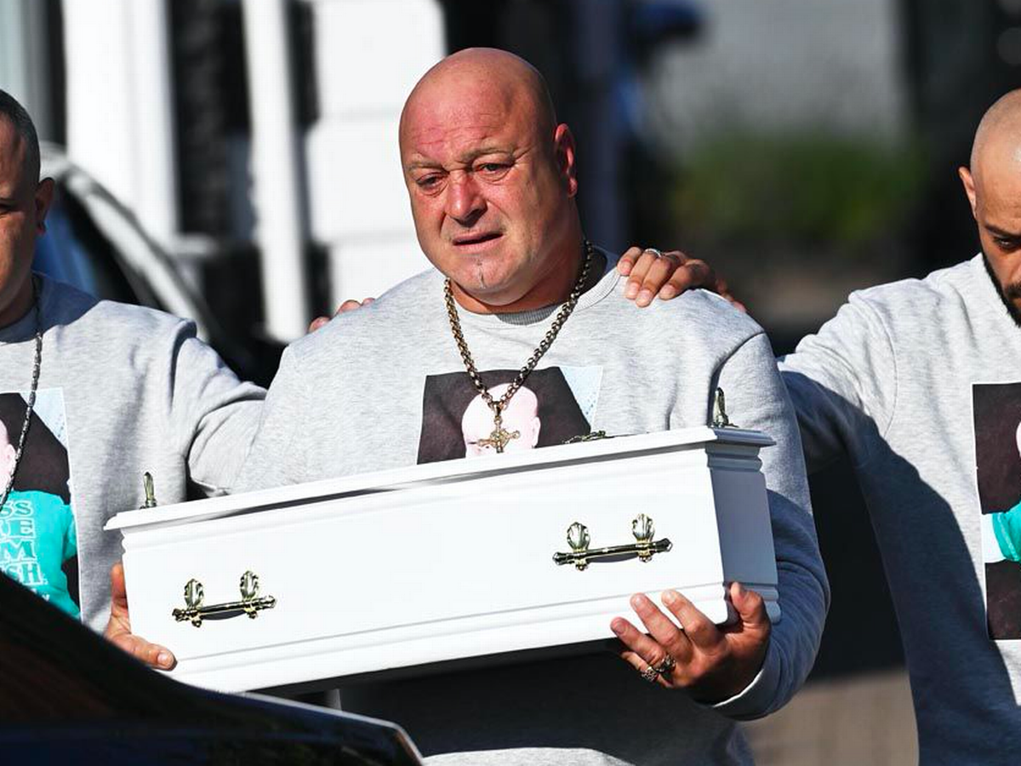
Solutions
Be flexible and prepared – you never know what’s about to happen.
But you will cope with it!

Slide 13
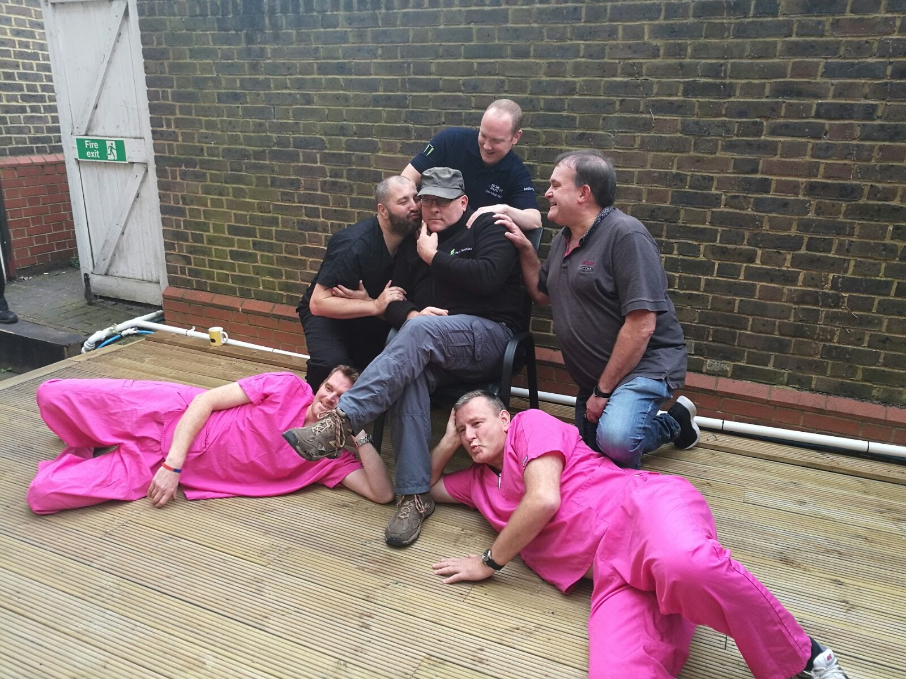
Solutions
Play together
Have fun (yes, really)

Slide 14
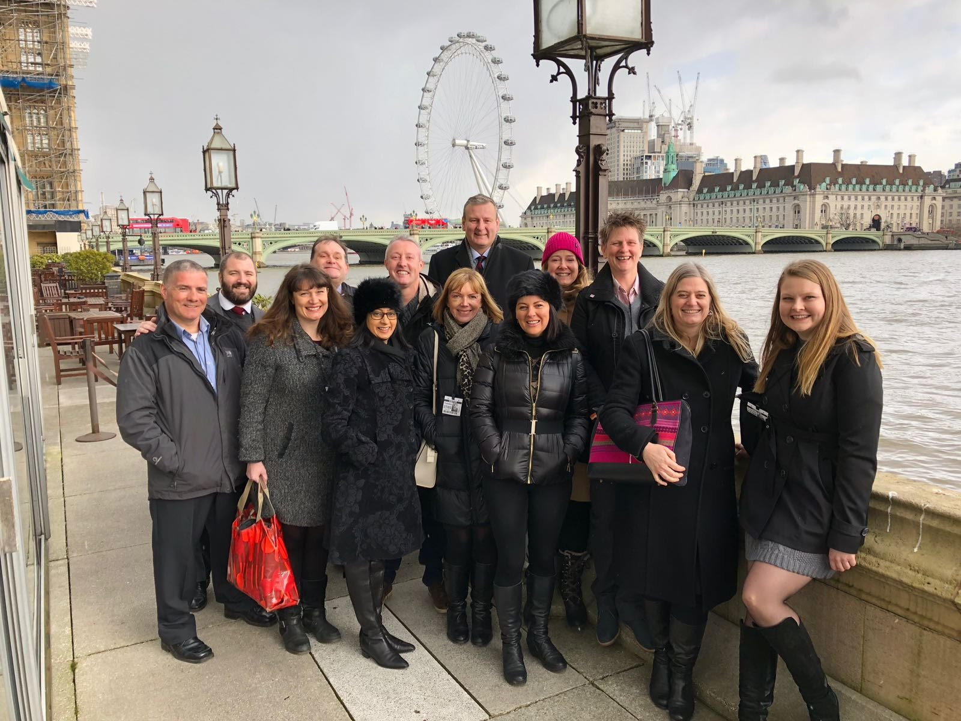
It doesn’t end when it’s over
Debrief
Don’t expect an end date for looking out for and looking after your team

Slide 15
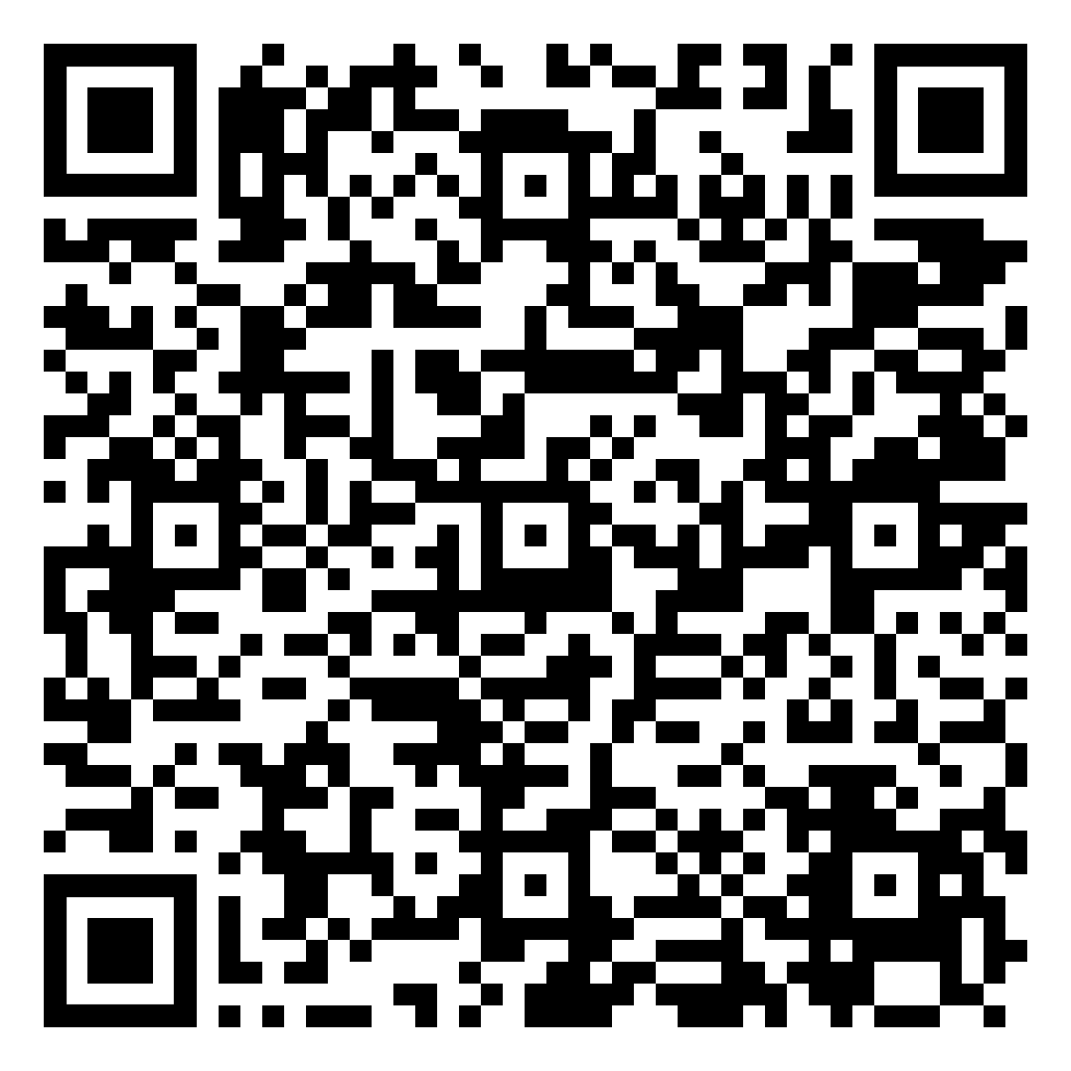
Capturing the learning
Review what happened and what you, and others did
What worked
What wouldn’t you do again.
Is there organizational or wider learning?
Capture it and share it with others – at the highest level you can

Slide 16
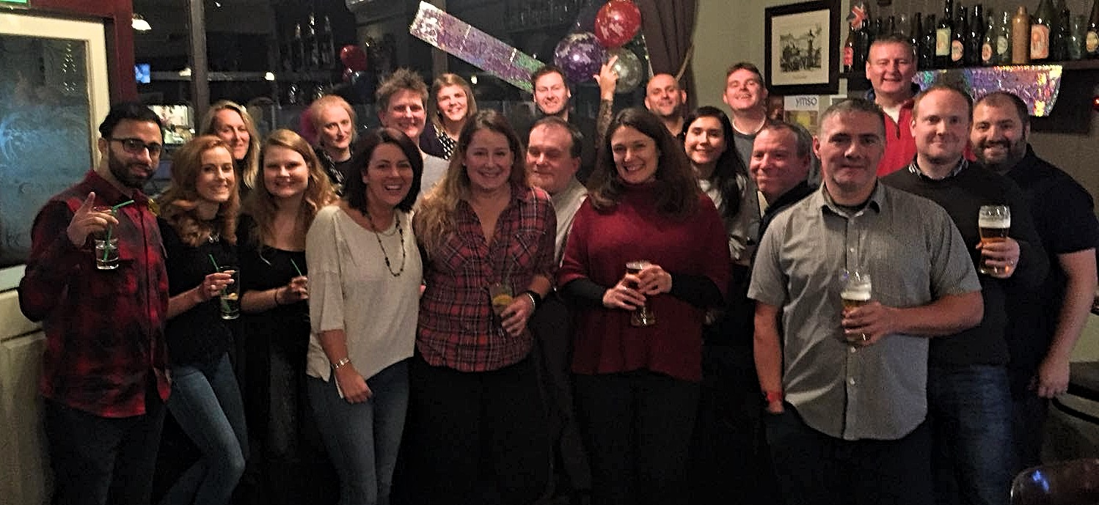
But the most important part is teamwork

