Slide 1
Oscar Kilo
The National Police Wellbeing Service
LIZ EADES
OH SME

Slide 2
About us
The National Police Wellbeing Service was launched in 2019 to provide support and guidance for police forces across England and Wales to improve and build organisational wellbeing.
It is an evidence based, sector specific service offering. Developed for policing, by policing, it is designed to meet the unique needs of police forces, officers and staff

Slide 3
Our ambition
Our ambition is for all people who work in policing to understand how to build personal resilience, feel confident they can speak up when things aren’t going well, and to get the best personalised support possible when they do

Slide 4

Working closely with College of Policing, the National Police Chiefs’ Council and the Home Office, we want to:
Help police forces build world–class wellbeing support for everyone who works for them
Improve knowledge and understanding of help and support available
Reduce stigma around seeking support or help
Encourage people to support themselves and realise their own potential
Improve personal resilience and self-help skills

Slide 5
Four pillars of the National Police Wellbeing Service
Promote
Prevent
Detect
and
support
Treat
and
recover

Slide 6
Four pillars - Promote
Actively promote positive wellbeing and psychological health and make mental health everyone’s business.
Promote

Slide 7
Four pillars - Prevent
Building robust resilience for officers and staff.
Acting to mitigate the stressors which will inevitably be encountered by officers, staff and their families.
Prevent

Slide 8
Four pillars – Detect and support
Effectively detect the early signs of psychological problems.
Provide effective support and signposting.
Detect
and
support

Slide 9
Four pillars – Treat and recover
Swift access to evidence-based treatment. Provided by teams skilled in the particular needs of police officers and staff.
Clear end-to-end support or treatment to return to work or, where appropriate, retirement with joined up care.
Treat
and
recover

Slide 10


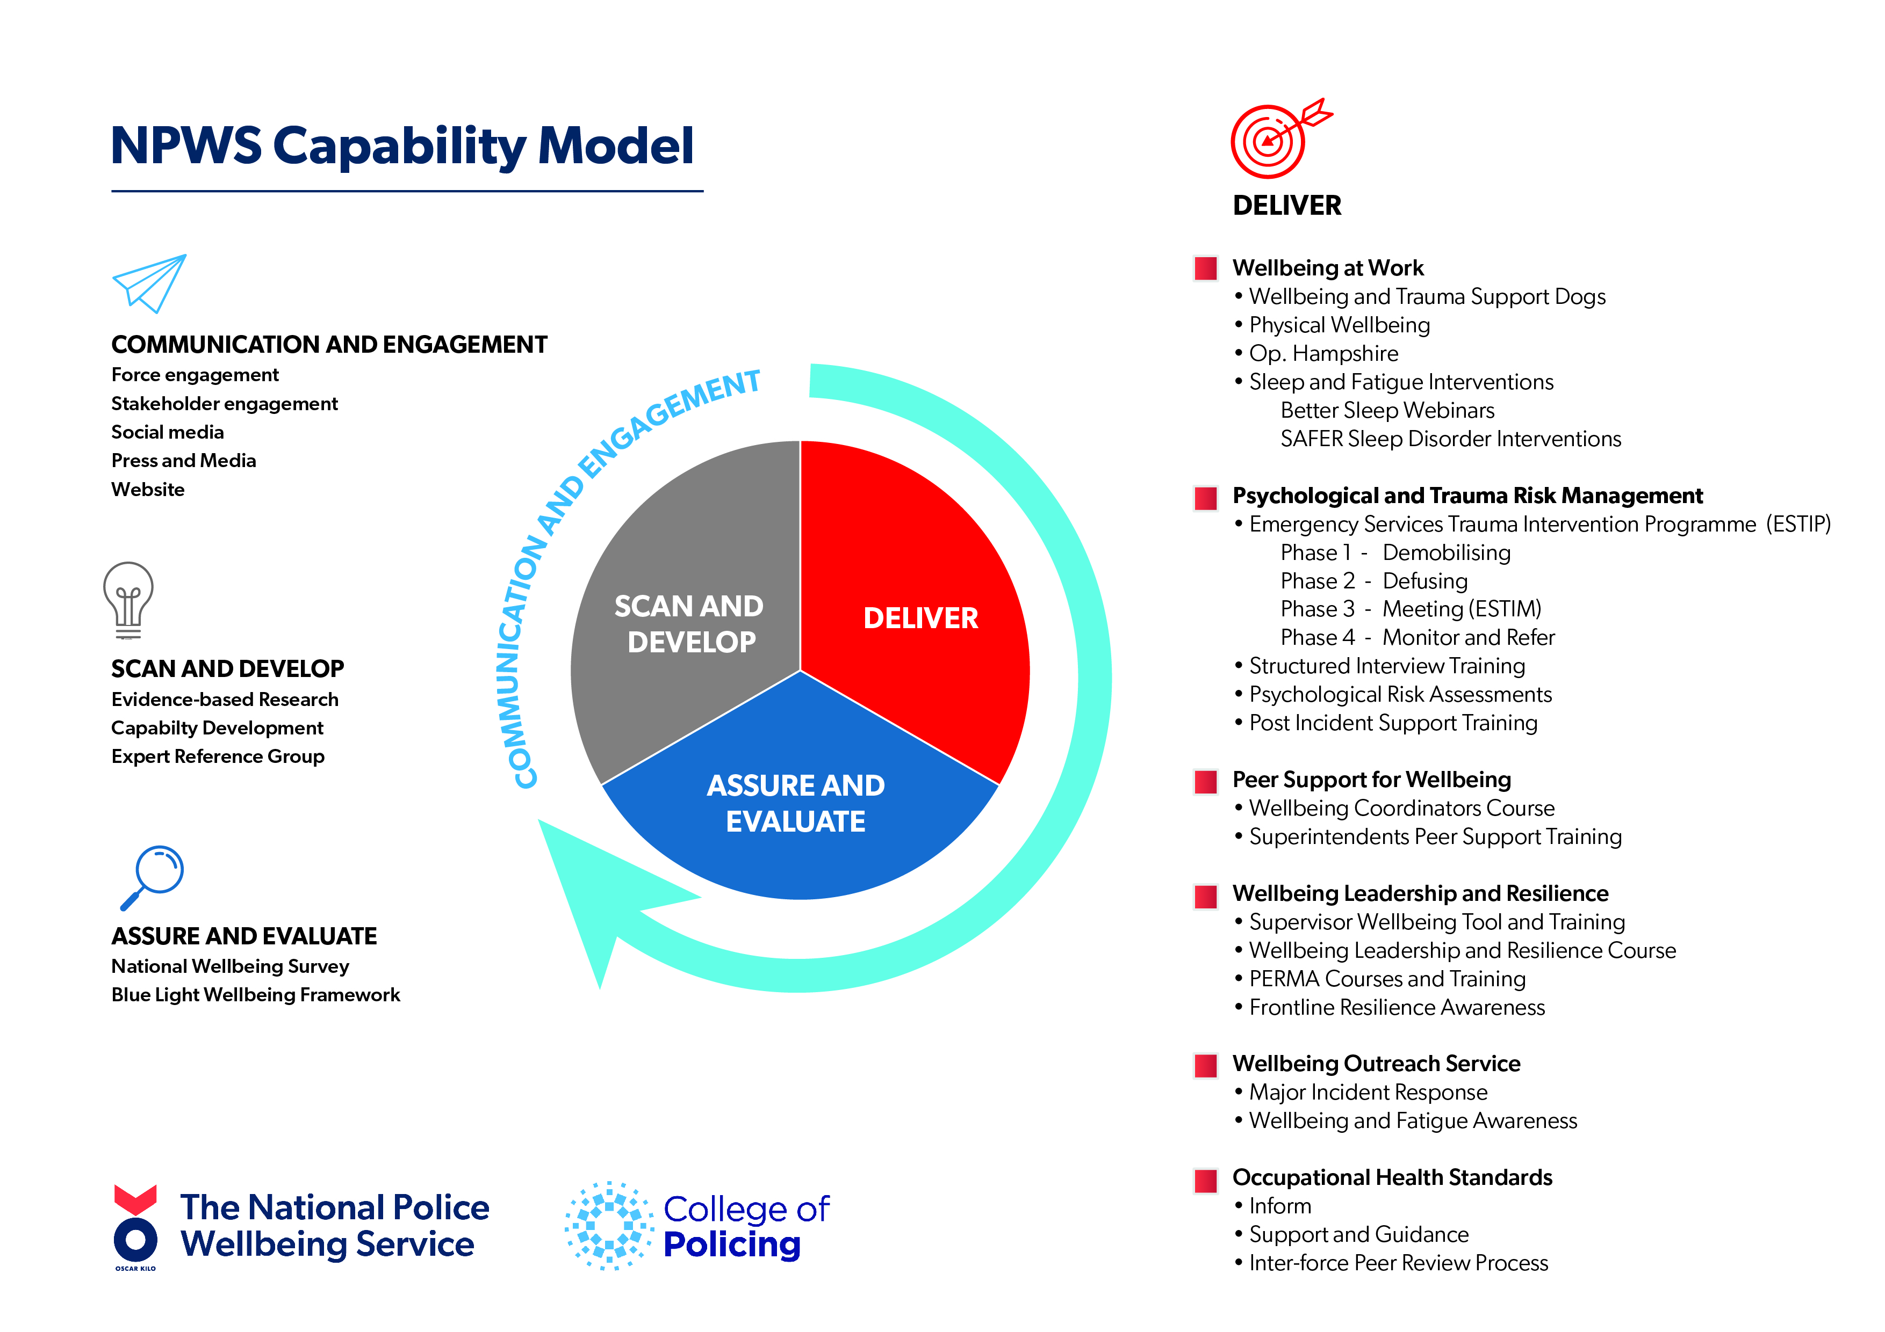
DELIVER
Wellbeing at work
Psychological and Trauma Risk Management
Peer Support for Wellbeing
Wellbeing Leadership and Resilience
Wellbeing Outreach Service
Occupational Health Standards
COMMUNICATION AND ENGAGEMENT
SCAN AND DEVELOP
ASSURE AND EVALUATE
Notes:
The National Police Wellbeing Service is based on learning and continuous improvement and so what we offer will grow and change over time.
The team is also working hard behind the scenes to scan and develop the wellbeing landscape through evidence based research, and using expert reference groups, staying on top of national and international trends.
This helps us look to the future and ensure we can continue to provide the most efficient and effective services to the forces that we’re working with.

Slide 11
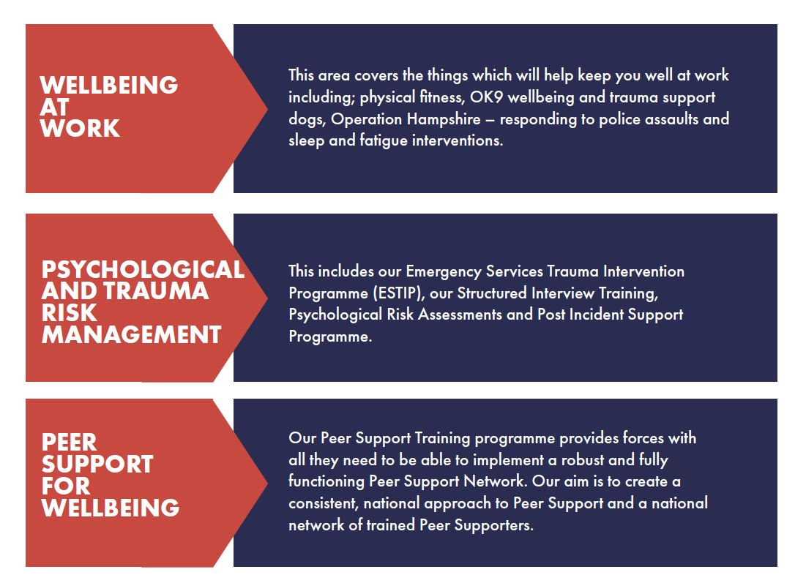
Our services

Slide 12
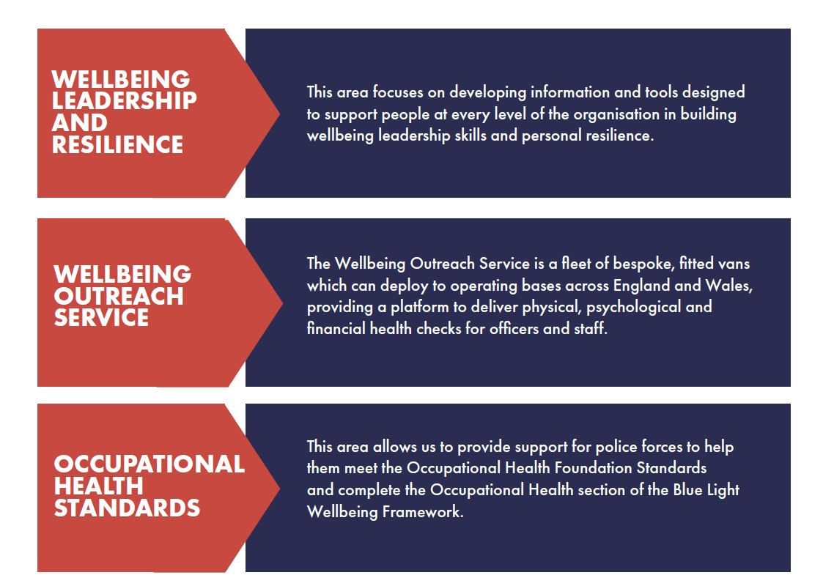
Our services

Slide 13
Occupational Health is about the effect of work on health and the effect of health on work

Slide 14
Occupational Health Standards Why?
All members of the police service need to :
- Understand the role of Occupational Health in supporting their health needs
- Know how to access Occupational Health
- Be confident that the clinical services offered to them are quality assured, consistent and underpinned by the best available evidence.
Chief Officers in police forces must:
- Be confident that their Occupational Health Services are properly constituted and comply with national standards
- Be reassured that investment in Occupational Health - Services will ensure compliance with legislation and meet the challenges of the National Wellbeing agenda

Slide 15
The ultimate aim of this initiative is to provide continuous improvement in OH services across policing in England and Wales

Slide 16
Foundation Occupational Health Standards Police Forces
Published in 2019 and now incorporated in the Blue Light Wellbeing Framework
Six Standards
Business Probity
Information Governance
People
Facilities and Equipment
Relationships with the organisation
Relationships with workers

Slide 17
Psychological Surveillance WHY
Health Surveillance is part of an organisations risk management strategy
Its about managing risk in relation to the role
Often applied to physical risks but equally should apply to psychological risk
Principles of risk management in psychological risk
  Identify the hazards ( who might be harm/ how)
  Assess the risk ( likelihood of harm)
  Control the risk (reduce exposure, provide support, debrief stec
  Monitor the control measures ( health surveillance fits here)

Slide 18
Psychological Surveillance HOW
There are a health of ways to monitor health
  Individual meetings
  Mandatory counselling
  Group meetings
  Paper Questionnaires
  Manager debriefs
  Periodic medicals
  Cross your fingers!

Slide 19
NPWS Psychological Surveillance Programme
Part of the Psychological and Trauma Risk Management Live Service
Psychological Surveillance and Structured Interviews are an effective way of understanding and reducing the risk of psychological ill health. The programme is designed to help police forces across the UK improve the mental health support they offer to officers and staff
Online questionnaire
Analysed by a clinician
Structured interview or other psychological interventions or support.
Yearly assessments
Helps identify clinical conditions such as anxiety, depression, PTSD and burnout
Creates a benchmark to identify changes in psychological wellbeing

Slide 20
High Risk Roles
Hostage and Crisis Negotiators
Paedophile Online Investigation (POLIT) and Internet Child Abuse (ICAT)
Serious Collision Investigation (SCIU) and Force Collision Investigation (FCIU)
Family Liaison Officers – Traffic
Family Liaison Officers – Crime
Violent and Sex Offender Register (VISOR) Teams
Digital Forensics Teams (DFT)
Counter Terrorism Units
Firearms Officers
Disaster Victim Identification Teams
Crime Scene Investigators
Offender Management Teams

Slide 21
WHAT IF?

Slide 22
Any questions?
More information:
Twitter: @OscarKiloUK
LinkedIn & YouTube: Oscar Kilo UK
Web: oscarkilo.org.uk

