Slide 1
Anxiety & Resilience
Natasha Hill

Slide 2
What is Wellbeing and Resilience?
Wellbeing is about how we are feeling in that snapshot of time
The Oxford Dictionary defines it as, the state of being comfortable, healthy or happy.
Life will throw things at us when we least expect them and we cant always be well
Resilience is the ability to be able to bounce back when we do have a bad day
The Oxford Dictionary defines resilience as the capacity to recover quickly from difficulties, toughness.
Ref Rown Gray, Life Coach

Slide 3
Wellbeing Check In – How do you feel today on a scale of 1-10?

Slide 4
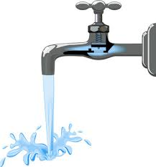
Work Load Stress
Lack of Sleep
Physical
Poor diet
Finances
Resilience is having a good working stress release tap on your bucket. If the tap is not working the bucket will over fill and problems will develop
Relationships
Cumulative Stress
Mindfulness
Sleep
Friends
Exercise
Healthy Nutrition
Rest

Slide 5
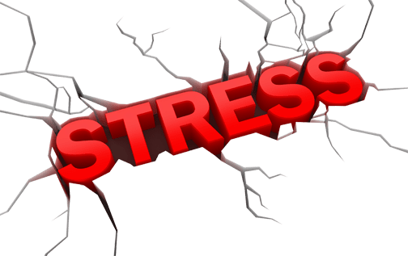
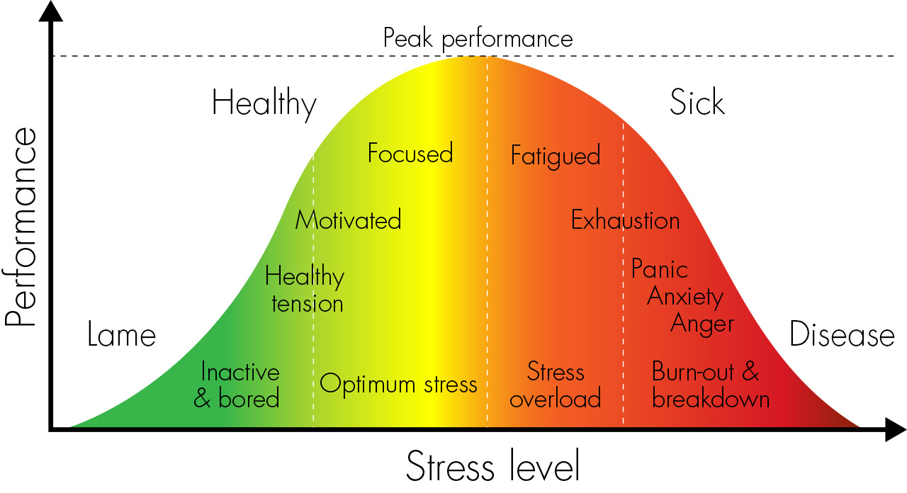

Slide 6
Stress &Trauma Signs and Symptoms
Physical & Behavioural
Withdrawal
Emotional Outbursts
Forgetfulness
Suspicion and paranoia
Poor communication
Inability to rest
Become anti-social
Irritability, erratic movements and pacing
Agitation and apprehension
Insomnia
Loss of appetite
Aggression
Change in activity and speech.
Loss of sex drive
Loss of appetite Drinking more alcohol
Smoking more
Withdrawal
Change in activity and speech.

Slide 7
Psychological
Signs and Symptoms
EMOTIONS
THOUGHTS
Blame others
Confusion
Poor attention, decisions, concentration and memory
Nightmares
Disorientation
Negative thinking
Indecisiveness
Obsessive thinking
Cynicism
Constant criticism of self or others
Anxiety
Sadness
Guilt ,
Low self-esteem,
Lack of confidence
Fear
Depression,
Intense anger
Flashbacks.
Extra Vigilant
Demotivated

Slide 8
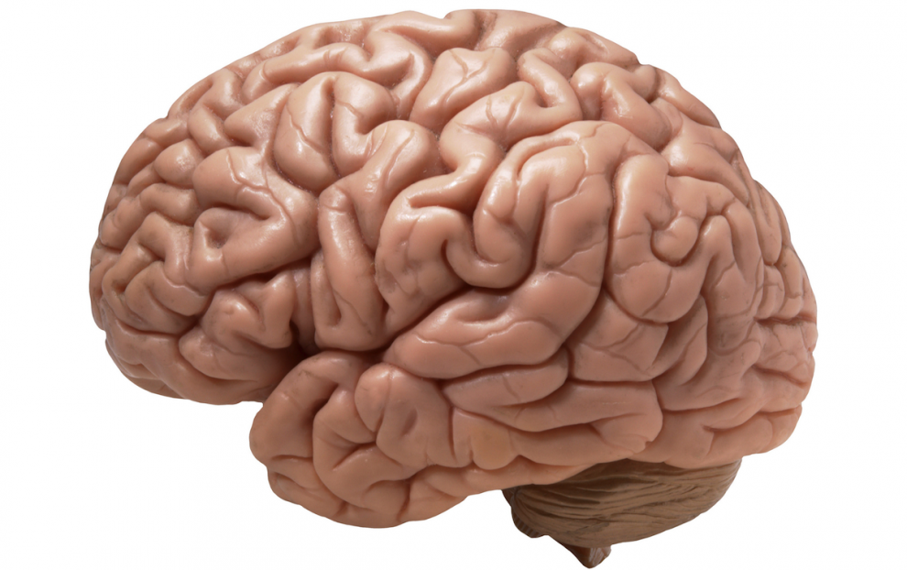
6
1
Disgust
Fear
Anger
Surprise
Sadness
Key to colours
{
5
2
Increase in sensations
Happiness
{
Decrease in sensations
4
3
Bodily Maps of Emotions, Nummenmaa et al, 2013, PNAS
© TME 2015
Notes:
Game based on research conducted by Aalto University published in 2013. Bodily maps of emotions. BASICALLY YOUR EARLY WARNING SYSTEM BECAUSE THOUGHTS CAN GIVE ARISE TO EMOTIONS WHICH AFFECT THE BODY BEFORE WE REALISE AN EMOTION HAS BEEN EVOKED.
You might think that most of what going on is in our brain BUT the brain is connected to the rest of our body. THE BODY IS WHERE EMOTIONS MAY BE FELT AS SENSATIONS TRIGGERED BY THE NERVOUS SYSTEM.
Emotions adjust our mental AND bodily states to cope with the challenges detected in our environment.
Emotions adjust our mental AND bodily states – this way they prepare us to react swiftly to dangers but also to opportunities such as pleasurable social interactions.
The body maps show regions whose activation increased (warm colours) or decreased (cool colours) during emotions.
WHICH OF THESE EMOTIONS GOES WITH EACH OF THE IMAGES OF SENSATIONS EXPERIENCED IN THE BODY? DISCUSS AS A GROUP. (SPLIT UP INTO 3 GROUPS?)
What's the learning here?
Each emotion is telling us what to do i.e Afraid –body preparing to run away, Angry – preparing to fight, disgusted – body preparing to reject or expel poison (Urging, sick feeling?)
Recognising body/mind connection gives us a foundation to live with more ease.
Recognising the body as a Radar. Each emotion is expressed as sensations in different parts of the body and we need to be aware of this.
Happiness is the one emotion where sensations are spread all over the whole body and the ONE EMOTION THAT DOES NOT REQUIRE ACTION.
Numerous studies have established that emotion systems prepare us to meet challenges encountered in the environment by adjusting the activation of the cardiovascular, skeletomuscular, neuroendocrine, and autonomic nervous system (ANS).
This link between emotions and bodily states is also reflected in the way we speak of emotions : a young bride getting married next week may suddenly have “cold feet,” severely disappointed lovers may be “heartbroken,” and our favorite song may send “a shiver down our spine.”

Slide 9
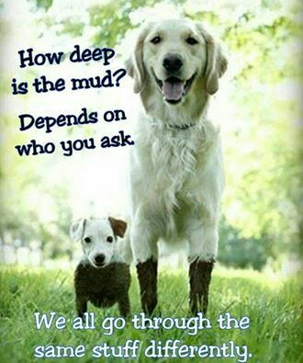

Slide 10
Thinking Traps
“Between stimulus and response, there is a space and, in that space, lies our freedom and power to choose our response” Victor Frankl, prisoner of war and trained Psychotherapist

Slide 11
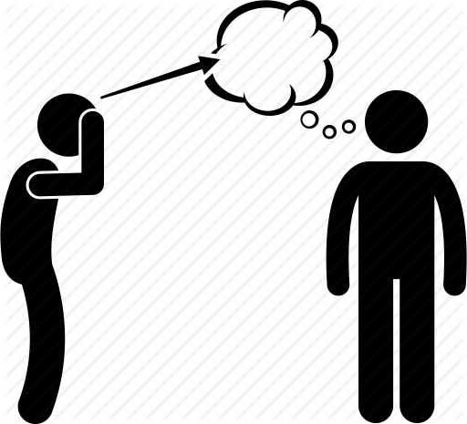
Mind Reading
Our first thoughts are not always helpful
We assume without real evidence we know what others are thinking & it tends to be negative
This can become a problem when it becomes rigid and we are convinced its true, it can block communication

Slide 12
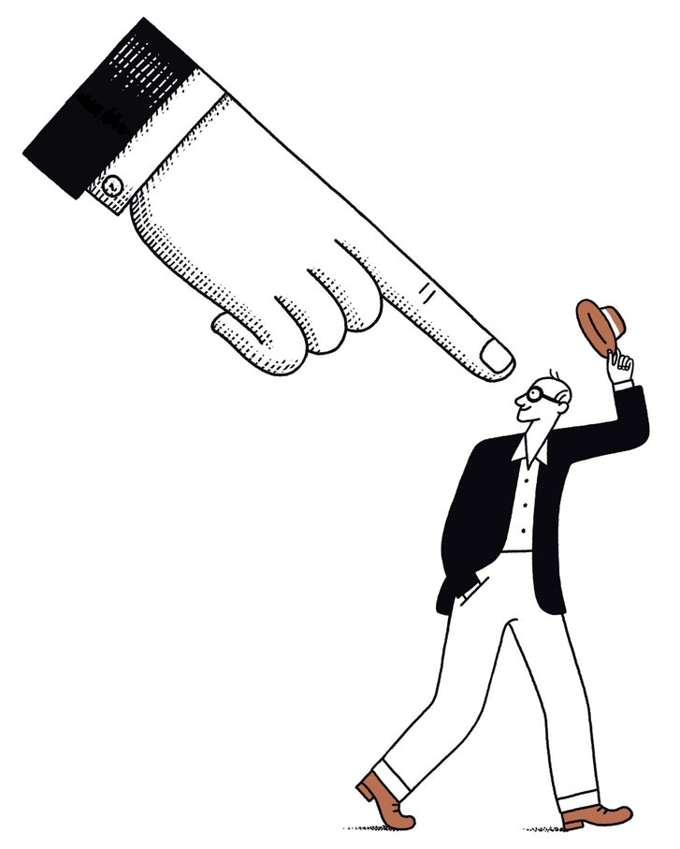
Personalising or the ‘Me’ trap
We personally think we are the sole reason for a negative situation and for the impact on others
This can cause guilt, sadness and make us withdraw

Slide 13
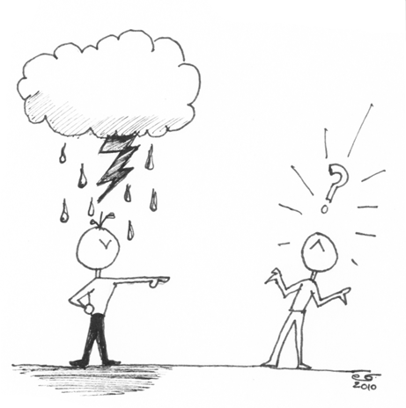
The ‘them’ trap
Where you tend to always blame others
Focus on the shortcomings and failings of others as the sole cause of your current setbacks and problems.

Slide 14
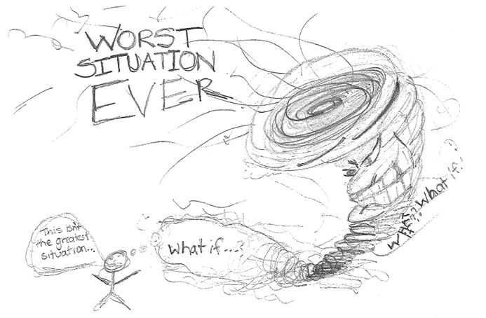
Catastrophising
Your Mind leaps to all the worst possible outcomes
Negative predictions can snowball

Slide 15
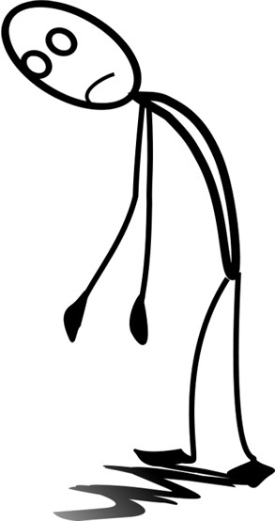
The ‘helpless’ thinking trap
The situation will negatively affect all areas of our life and the impact will last a long time
There is little we can do, and it can become very toxic

Slide 16
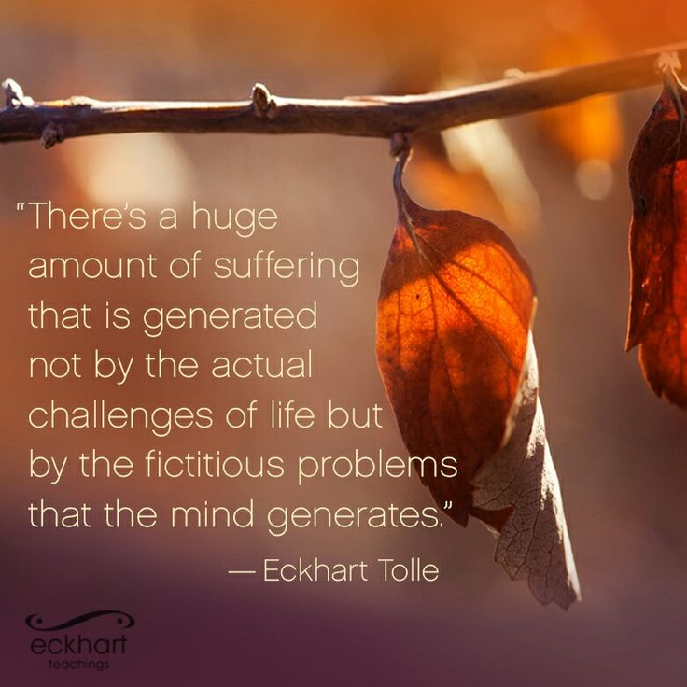

Slide 17
Why do I worry?
There has been a huge increase in anxiety over the last two years
Two aspects – your mind and worry and your relationship with worry
What do you worry about?
How many of these worries come true? – consider changing your thought process from “what if” to “then what” – more resolution focused and you can start to think about how to manage a particular situation.
Make space for dedicated ‘worry time’ – 10 minutes each day and write down your worries
Go back to your list of worries – are there any you can let go of?

Slide 18
Practical Things to Try
Think of 3 good things that have happened over the last 24 hours, things you enjoyed or were pleased about, big or small. Write them down including why they were good
Think about your daily habits – what is the first thing you do when you wake up
Take 5/10 minutes at the start of each day just for you – it must not involve a smart phone and you must not feel guilty about doing it!
Journaling
Music
What do you do first thing in the morning and last thing at night
Mindfulness

Slide 19
Live Life Mindfully….
Living in the here and now helps us
Think more clearly
Feel more calm
Cope better
Reduces stress & Anxiety

Slide 20
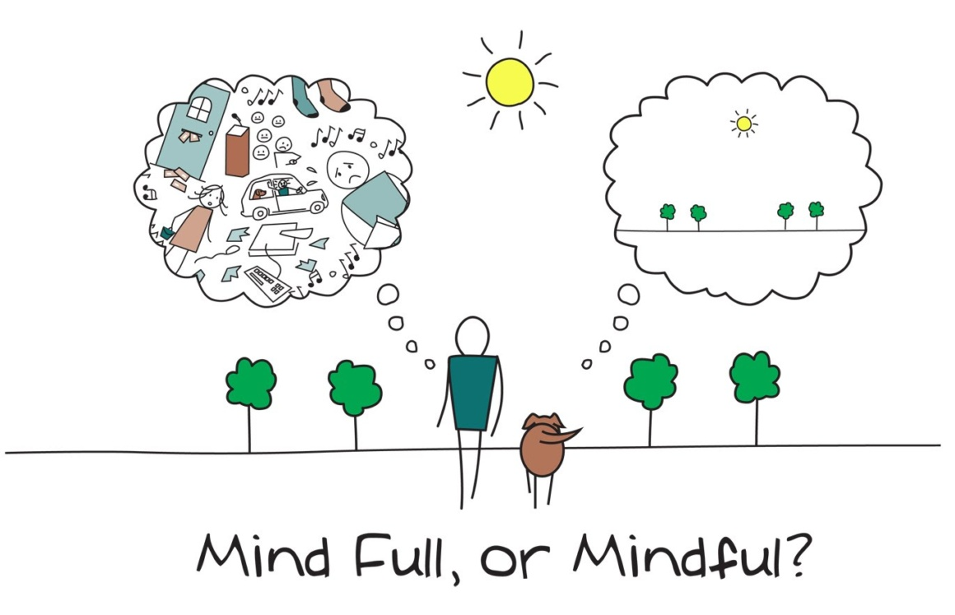

Slide 21
10 Minute Mindfulness Sessions on Teams
App’s – Headspace/Calm/Samten/Buddify
You Tube & Netflix series
5 Week Mindfulness Course on Teams – based on the book Mindfulness A Practical Guide to Finding Peace in a Frantic World by Danny Penman and Mark Williams

Slide 22
Nourishing Activities: Those things that lift your mood or give you energy.
Depleting Activities: Those things that dampen your mood or take your energy.

Slide 23
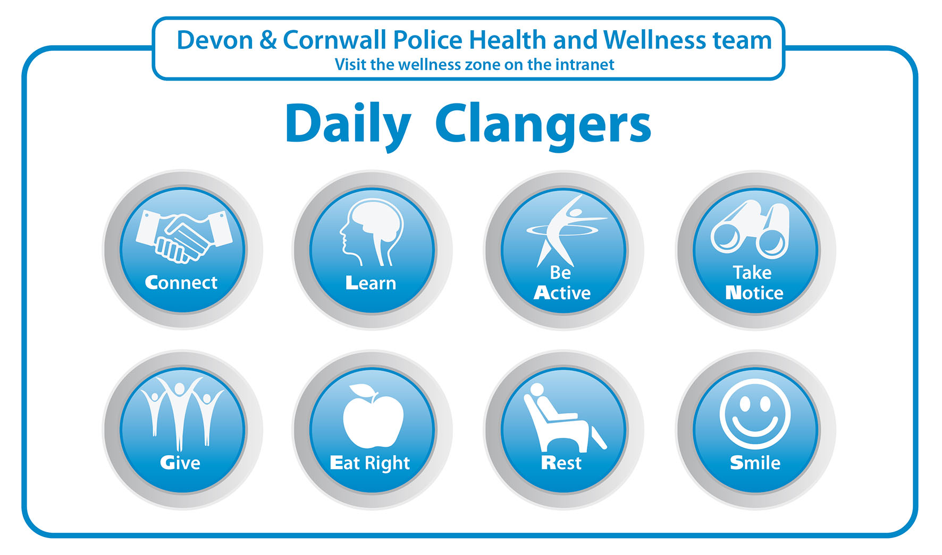
Self Care and Compassion is NOT selfish
Notes:
Model and encourage healthy life habits to your team and your family
Have regular wellbeing conversations at work and home

Slide 24
ANY QUESTIONS?

